Slide 1
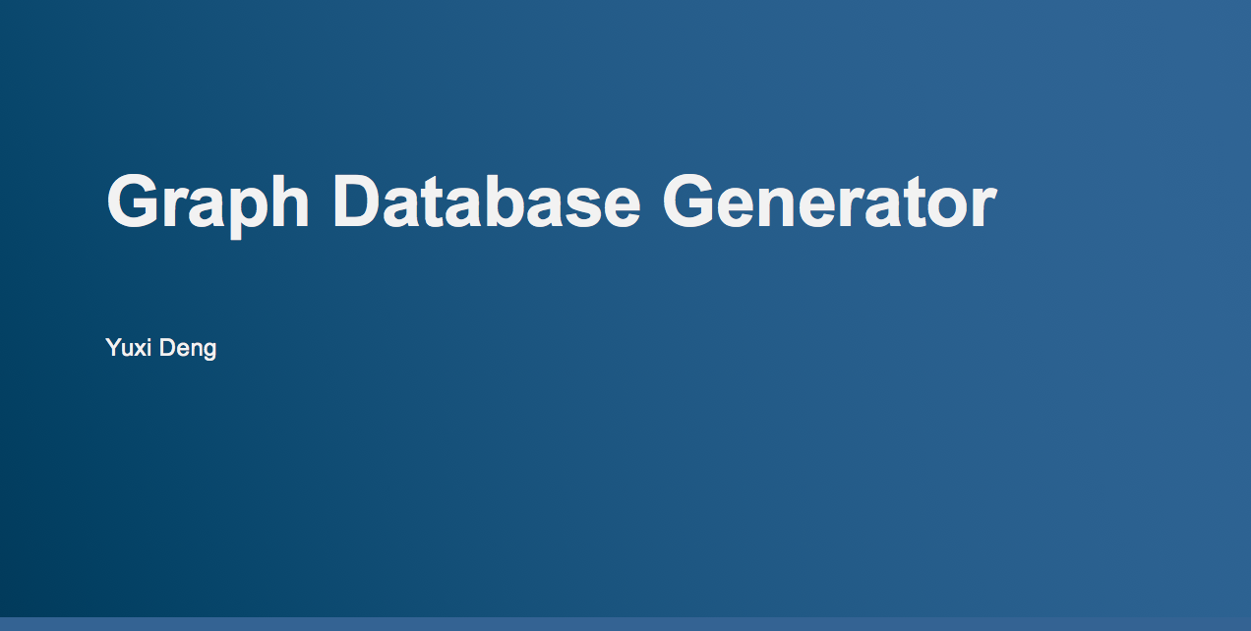

Slide 2
Relationships and Network in business
Initial motivation: Estimate the premier for Director and Officer Insurance
Potential collaboration
shared or conflicted interests
The capability of directors

Slide 3
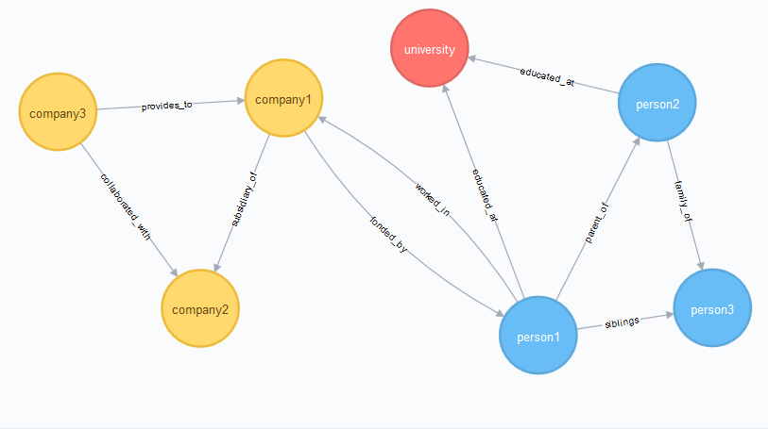
Data Model

Slide 4
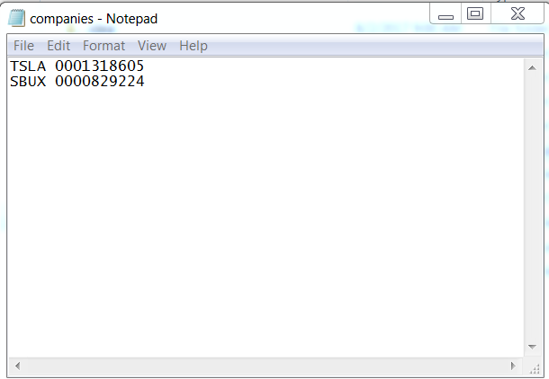
input

Slide 5
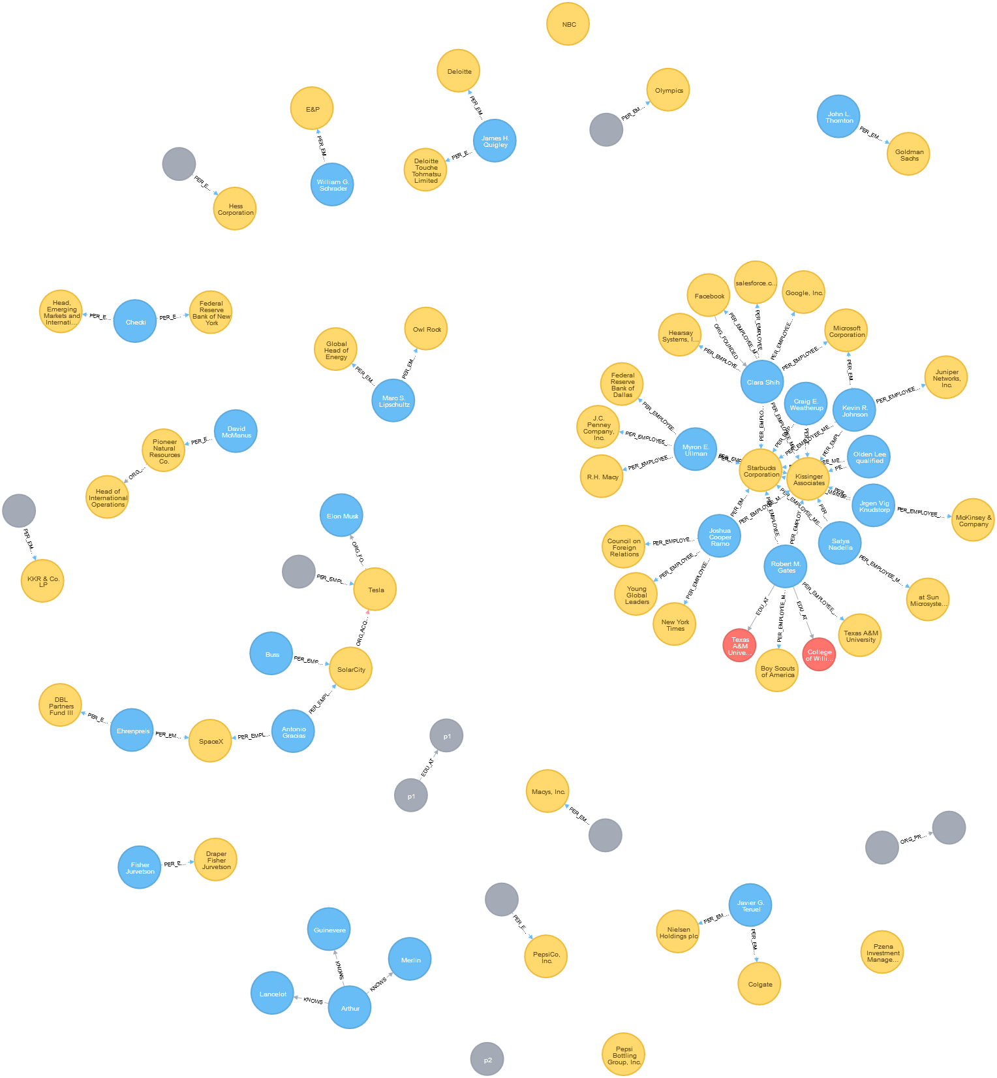
output

Slide 6






Identify Problem
Data Gathering
Data Cleaning
Data Analysis
Output format
DEF 14A webcrawler
Rosette API
Biography of directors and candidates including past companies and education. Not formatted in a consistent style
Relationships and entities extraction.
Relationships
HTML Tags
Neo4j Driver
Between directors and officers from interested companies
Removing all tags for more efficiency data processing
Graph Database Platform that builds and query graph database.

Slide 7
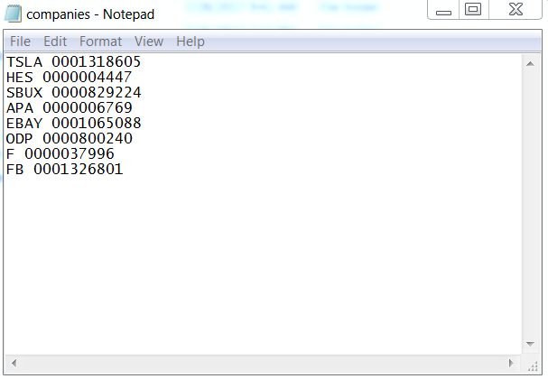

Slide 8
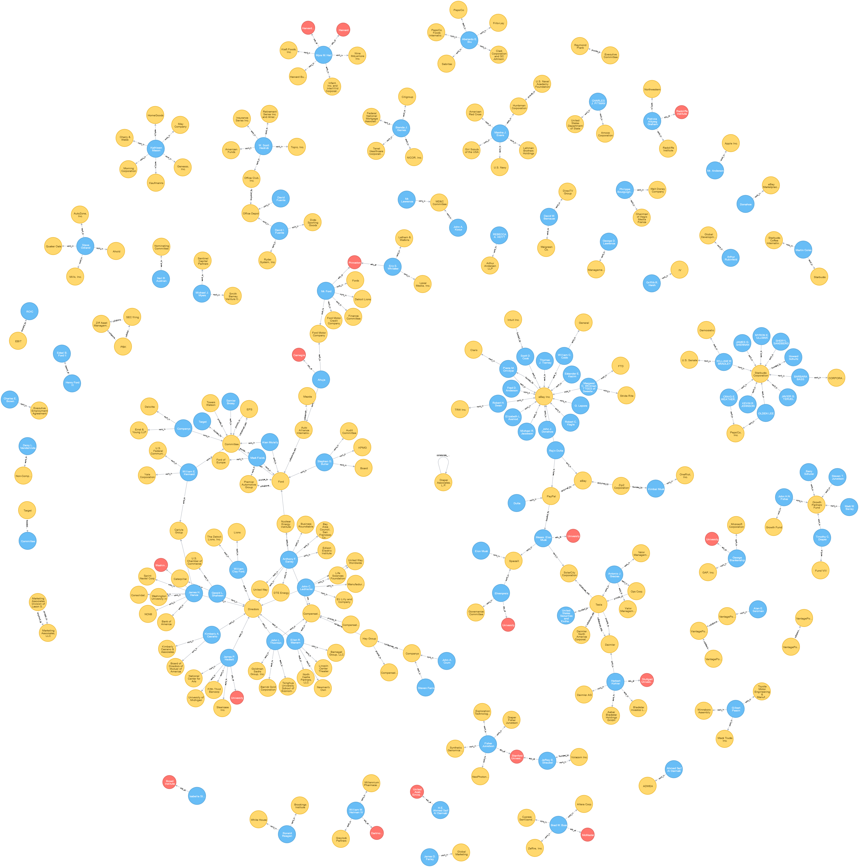

Slide 9
Demo time!
Choose any public traded company

Slide 10
FAQs
Does it only work for public traded companies?
Partly. Data analysis an output graph database will remain the same
How do I get CIK number?
There is a file with all companies’ names and CIK to look up
Sec.gov

Slide 11
What’s next
Validate normalized name
Clear duplicates by linking back to entity extraction
Data Augmentation
Adding labels
Scale up from 8 to 3000
Threads, GPU and parallelism
Cloud services

Slide 12
Thank you!

